Slide 1
Background Tasks
Android Developer Fundamentals
Lesson 8
This work is licensed under a Creative Commons Attribution-NonCommercial 4.0 International License

Slide 2
8.2 Alarm Manager
This work is licensed under a Creative Commons Attribution-NonCommercial 4.0 International License

Slide 3
Contents
What are Alarms
Alarms Best Practices
Alarm Manager
Scheduling Alarms
More Alarm Considerations

Slide 4
What Are Alarms

Slide 5
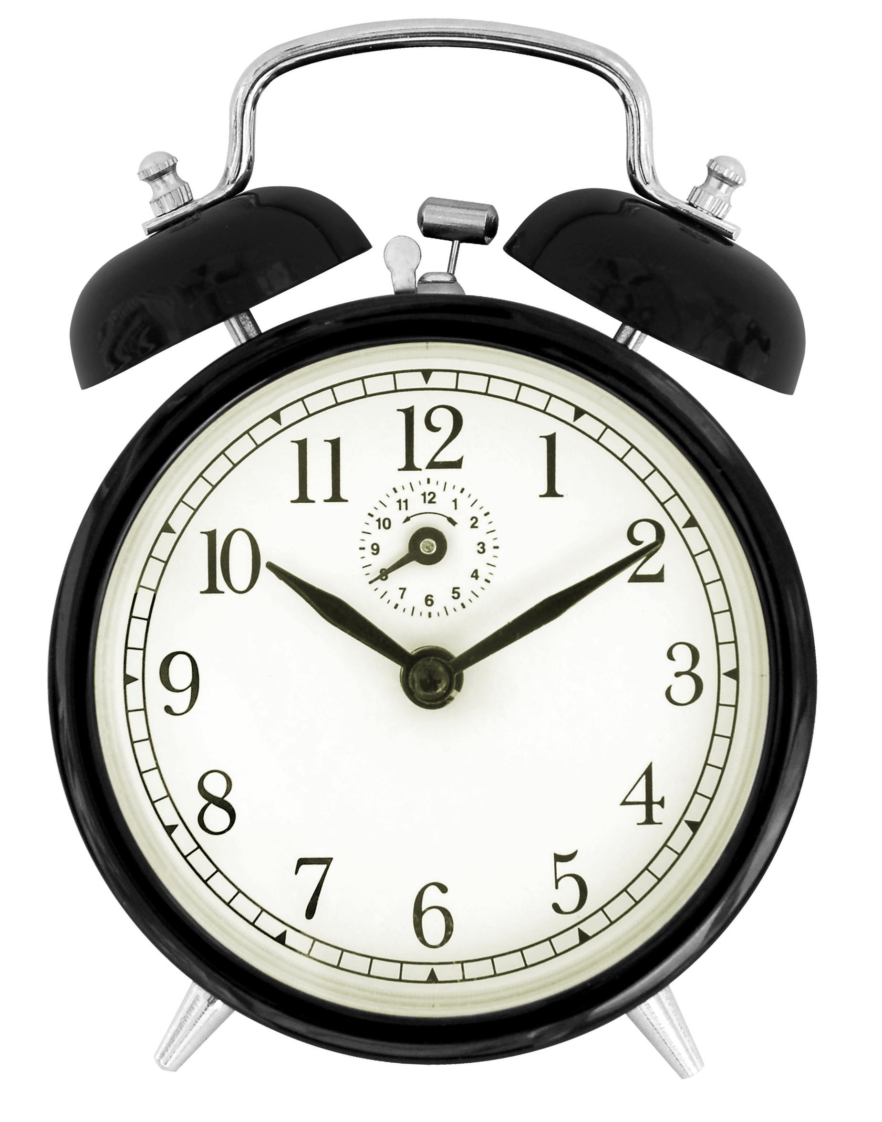
What is an alarm in Android?
Not an actual alarm clock
Schedules something to happen at a set time
Fire intents at set times or intervals
Goes off once or recurring
Can be based on a real-time clock or elapsed time
App does not need to run for alarm to be active

Slide 6
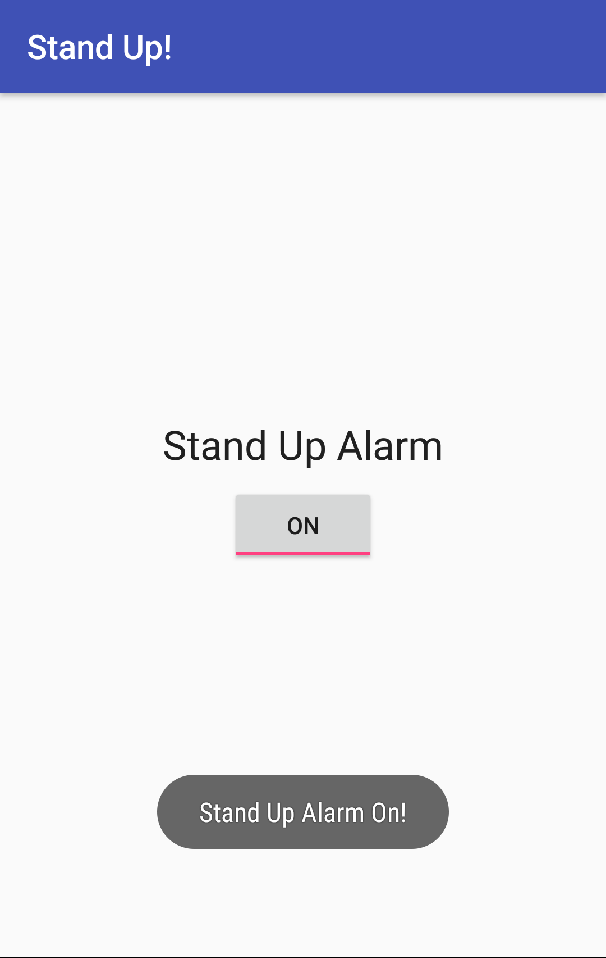
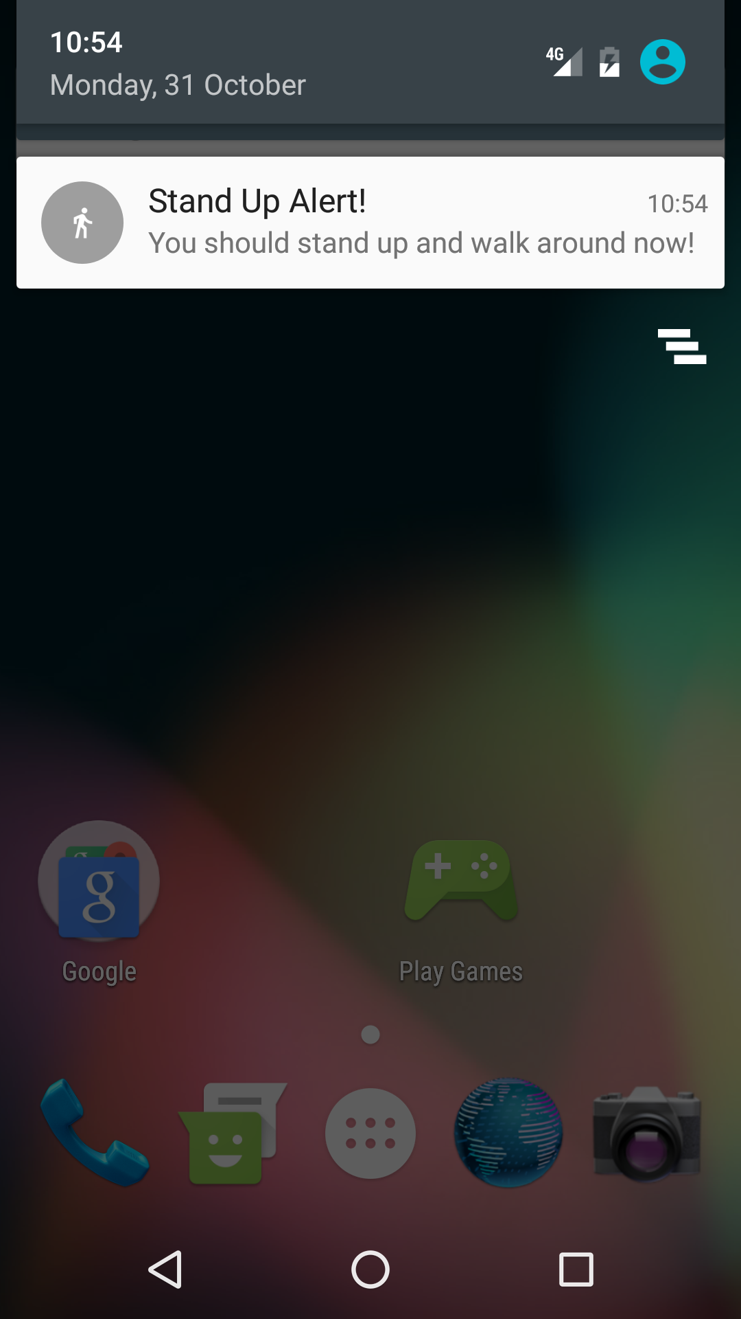
How alarms work with components
BroadcastReceiver
wakes up and
delivers notification
BroadcastReceiver
wakes up
delivers notification
Activity creates notification manager and
sets alarm
Alarm triggers and sends out intent
App may be destroyed so….

Slide 7
Benefits of alarms
App does not need to run for alarm to be active
Device does not have to be awake
Does not use resources until it goes off
Use with BroadcastReceiver to start services and other operations

Slide 8
Measuring time
Elapsed Real Time—time since system boot
Independent of time zone and locale
Use for intervals and relative time
Use whenever possible
Elapsed time includes time device was asleep
Real Time Clock (RTC)—UTC (wall clock) time
When time of day at locale matter

Slide 9
Wakeup behavior
Wakes up device CPU if screen is off
Use only for time critical operations
Can drain battery
Does not wake up device
Fires next time device is awake
Is polite

Slide 10
Types of alarms
 | Elapsed Real Time (ERT)—since system boot | Real Time Clock (RTC)—time of day matters
Do not wake up device | ELAPSED_REALTIME | RTC
Wake up | ELAPSED_REALTIME_WAKEUP | RTC_WAKEUP

Slide 11
Alarms Best Practices

Slide 12
If everybody syncs at the same time...
Imagine an app with millions of users
Server sync operation based on clock time
Every instance of app syncs at 11:00 p.m.
Load on the server could result in high latency or even "denial of service"

Slide 13
Alarm Best Practices
Add randomness to network requests on alarms
Minimize alarm frequency
Use ELAPSED_REALTIME, not clock time, if you can

Slide 14
Battery
Minimize waking up the device
Use inexact alarms
Android synchronizes multiple inexact repeating alarms and fires them at the same time
Reduces the drain on the battery.
Use setInexactRepeating() instead of setRepeating()

Slide 15
When not to use an alarm
Ticks, timeouts, and while app is running—Handler
Server sync—SyncAdapter with Cloud Messaging Service
Inexact time and resource efficiency—JobScheduler

Slide 16
AlarmManager

Slide 17
What is AlarmManager
AlarmManager provides access to system alarm services
Schedules future operation
When alarm goes off, registered Intent is broadcast
Alarms are retained while device is asleep
Firing alarms can wake device

Slide 18
Get an AlarmManager
AlarmManager alarmManager =
(AlarmManager) getSystemService(ALARM_SERVICE);

Slide 19
Scheduling Alarms

Slide 20
What you need to to schedule an alarm
Type of alarm
Time to trigger
Interval for repeating alarms
PendingIntent to deliver at the specified time (just like notifications)

Slide 21
Schedule a single alarm
set()—single, inexact alarm
setWindow()—single inexact alarm in window of time
setExact()—single exact alarm
More power saving options AlarmManager API 23+

Slide 22
Schedule a repeating alarm
setInexactRepeating()
repeating, inexact alarm
setRepeating()
Prior to API 19, creates a repeating, exact alarm
After API 19, same as setInexactRepeating()

Slide 23
setInexactRepeating()
setInexactRepeating(
int alarmTtype,
long triggerAtMillis,
long intervalMillis,
PendingIntent operation)

Slide 24
Create an inexact alarm
alarmManager.setInexactRepeating(
AlarmManager.ELAPSED_REALTIME_WAKEUP,
SystemClock.elapsedRealtime()
+ AlarmManager.INTERVAL_FIFTEEN_MINUTES,
AlarmManager.INTERVAL_FIFTEEN_MINUTES,
notifyPendingIntent);

Slide 25
More Alarm Considerations

Slide 26
Checking for an existing alarm
boolean alarmExists =
(PendingIntent.getBroadcast(this,
0, notifyIntent,
PendingIntent.FLAG_NO_CREATE) != null);

Slide 27
Doze and Standby
Doze—completely stationary, unplugged, and idle device
Standby—unplugged device on idle apps
Alarms will not fire
API 23+

Slide 28
User visible alarms
setAlarmClock()
System UI may display time/icon
Precise
Works when device is idle
App can retrieve next alarm with getNextAlarmClock()
API 21+

Slide 29
Cancel an alarm
Call cancel() on the Alarm Manager
pass in the PendingIntent
alarmManager.cancel(alarmPendingIntent);

Slide 30
Alarms and Reboots
Alarms are cleared when device is off or rebooted
Use a BroadcastReceiver registered for the BOOT_COMPLETED event and set the alarm in the onReceive() method

Slide 31
Learn more
Schedule Repeating Alarms Guide
AlarmManager reference
Choosing an Alarm Blog Post
Scheduling Alarms Presentation
Optimizing for Doze and Standby

Slide 32
What's Next?
Concept Chapter: 8.2 C Scheduling Alarms
Practical: 8.2 P Alarm Manager

Slide 33
END

